Slide 1
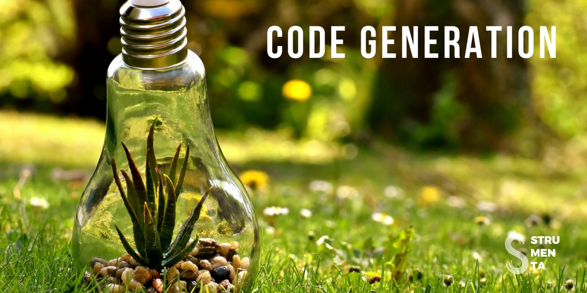
By :- Rishabh Singh
500061070
R171217050

Slide 2
INTRODUCTION
Code generators, also called application generators, have significant advantages, by taking a set of inputs provided by the developers, they start the development process. These generators automate the development process.
Code generation tools help in creating applications from scratch that can run on a specific platform and have the capability to generate bug-free, reliable basic set of code as compared to manual code written by developers. Testing and bug-fixing thus become easier..
Code Generation can be used for small portions of code or entire applications. It can be used with widely different programming languages and using different techniques.
There exists some sophisticated code generators that can deliver code in accordance with predefined functionalities and have the ability to generate complex web pages including reports, forms, and other complex features.
Active code generators generate code and keep track throughout its Lifecycle. Passive code generators’ job gets over once the code is generated.

Slide 3
Uses for Code Generation:
We can generate repetitive code from schemas or source of information we have. For example, we can generate Data Access Objects from database schema files
We can generate code from wizards
We can generate skeletons of applications from simple models.
We can generate entire applications from high level DSLs(Domain Specific Languages)
We can generate code from information we obtained processing existing documents
We can generate code from information we obtained by reverse-engineering code written using other languages or frameworks
We can generate code, using programming languages with powerful metaprogramming features
Some IDEs have the functionality to generate boilerplate code, like the equals or hashCode methods in Java

Slide 4
Why to Use Code Generation
Why NOT to Use Code Generation
Productivity:- With code generation you write the generator once and it can be reused as many times as you need. Providing the specific inputs to the generator and invoke it is significantly faster than writing the code manually, therefore code generation permits to save time.
Simplification:- With code generation you generate your code from some abstract description. It means that your source of truth becomes that description, not the code. That description is typically easier to analyse and check compared with the whole generated code.
Portability:- Once you have a process to generate code for a certain language or framework you can simply change the generator and target a different language or framework. You can also target multiple platforms at once. For example, with a parser generator you can get a parser in C#, Java and C++. Another example: you might write a UML diagram and use code generation to create both a skeleton class in C# and the SQL
Maintenance:- When you use a code generator tool your code becomes dependent on it. A code generator tool must be maintained. If you created it you have to keep updating it, if you are just using an existing one you have to hope that somebody keep maintaining it or you have to take over yourself. So the advantages of code generation are not free.
Complexity:- Code generated automatically tend to be more complex than code written by hand. In this second case the generated code can do more than what you want, but this is not necessarily an advantage. Generated code is also surely less optimized than the one you can write by hand. Sometimes the difference is small and not significant, but if your application need to squeeze every bit of performance code generation might not be optimal for you.

Slide 5
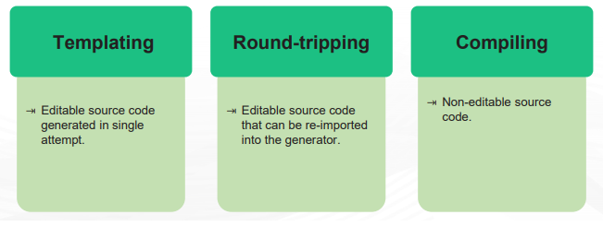
Categories of Code Generators:
There Are 3 types of code Generators:-
Code generators can also be categorized as follows:
Database script generators: Relational database models are created and updated by means of incremental scripts.
Application source code generators: Code is generated in any programming language.

Slide 6
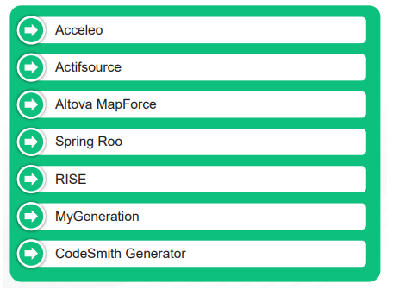
Examples of Code Generators

